Slide 1
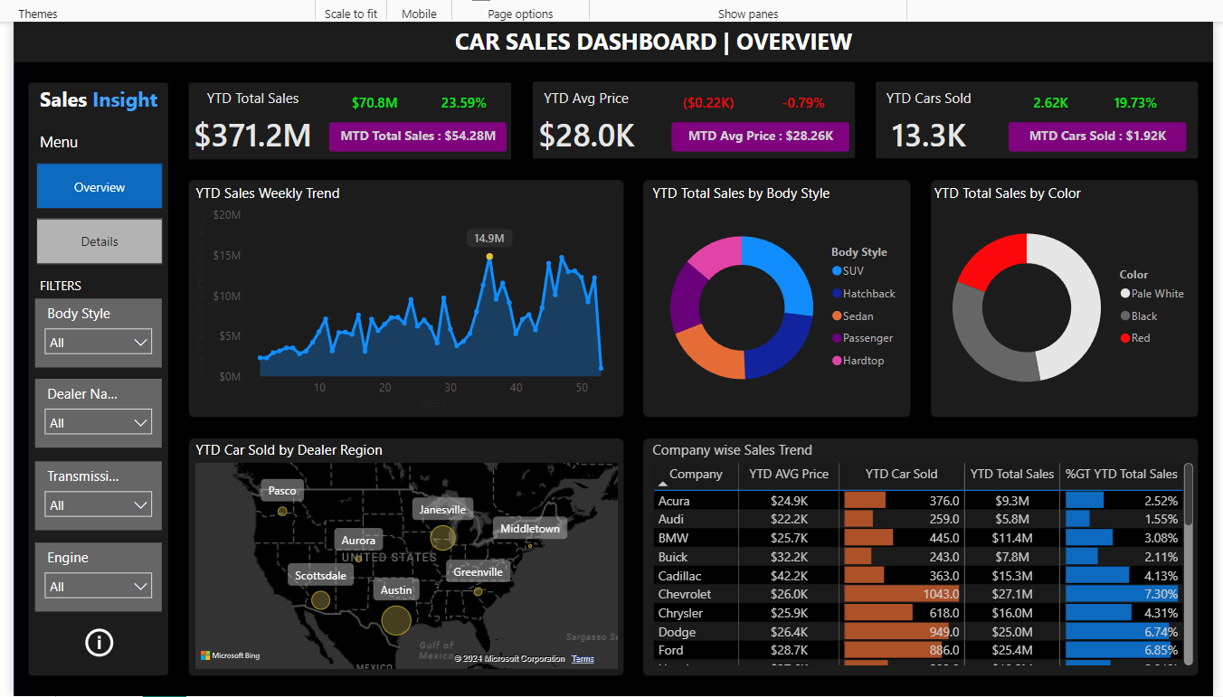
CAR SALES INSIGHTS

Slide 2
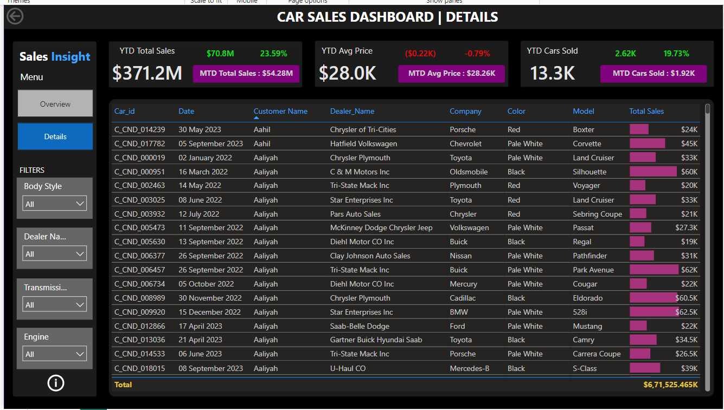
CAR SALES INSIGHTS

Slide 3


CAR SALES INSIGHTS
Objective: The objective of this project is to design and develop a dynamic and interactive Car Sales Dashboard using Power BI. The dashboard will visualize critical KPIs related to our car sales, helping us understand our sales performance over time and make data-driven decisions.
KPI’s Requirement: The dashboard should provide real-time insights into key performance indicators (KPIs) related to our sales data. This will enable us to make informed decisions, monitor our progress, and identify trends and opportunities for growth.

Slide 4
CAR SALES INSIGHTS
KPI’s Insights :
Sales Overview:
Year-to-Date (YTD) Total Sales - $371.2M
Month-to-Date (MTD) Total Sales - $54M
Year-over-Year (YOY) Growth in Total Sales – 23.59%
Difference between YTD Sales and Previous Year-to-Date (PTYD) Sales - $70.8M
Average Price Analysis:
YTD Average Price - $28.0K
MTD Average Price - $28.26K
YOY Growth in Average Price – (0.79%)
Difference between YTD Average Price and PTYD Average Price – ($223.5)

Slide 5
CAR SALES INSIGHTS
Cars Sold Metrics:
YTD Cars Sold – 13.3K
MTD Cars Sold – 1.9K
YOY Growth in Cars Sold – 19.73%
Difference between YTD Cars Sold and PTYD Cars Sold – 2.62K
Developed by : Ajay Kumar Kushwaha

